Slide 1
Lecture 1
Computer Basics

Slide 2
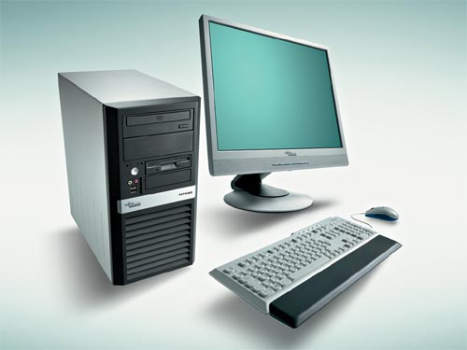
What is Computer?
Figure 1: A Computer

Slide 3
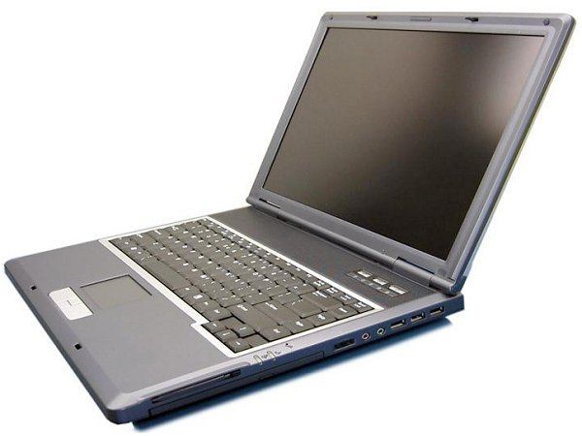
What is Computer? (Continue)
Figure 2: Another Computer

Slide 4
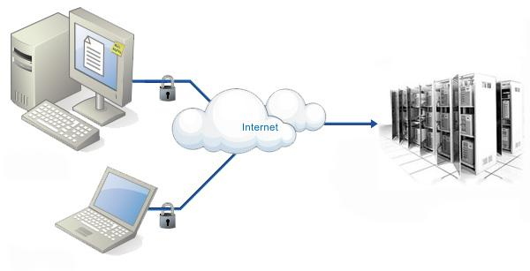
What is Computer? (Continue)
Figure 3: A collection of Computers

Slide 5
What is Computer? (Continue)
A computer is an electronic device that processes data, converting it into information that is useful to user.
Automatic machine
Made up of electronic and electro-mechanical devices
Processes data under program control
Generates meaningful information
Operates with speed and accuracy
Also known as Electronic Data Processor (EDP) or Automatic Data Processor

Slide 6
Data Processing
Data
Data Processing
Information
Figure 4: Data Processing
The process through which data is converted to information is called data processing.
Data is the input to the process.
Information is the output of the process.

Slide 7
Data Processing (Continue)
Data
Plural form of Datum means facts.
All facts and figures or description of a person, object, condition, situation or idea.
Every field of activity produces data.
Example: names of employees, grades obtained by students.

Slide 8
Data Processing (Continue)
Information
1. Information is the processed data that is organized and meaningful to the user receiving it.
2. Data is the raw material that is transformed into information by processing.
3. Example: The temperature, atmospheric pressure, humidity (data) of a certain place provides lovely sunny day, cloudy day, rainy day (information).

Slide 9
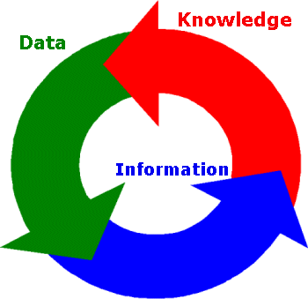
Data Processing (Continue)
Figure 5: Data Processing Cycle

Slide 10
Characteristics of Computers
Speed: Speed of execution of operations. Unit: Hertz. Now several million operations per second.
Automatic Operation: Automatic in operations.
Storage: Both data and specified sequence of instructions must be stored in the computer in advance. Terms: Word, Byte
Versatility: It can do wide range of tasks.
Diligence: Never feel boredom, good at iterative works.
Reliability: Never makes mistake and results are always same.

Slide 11
Basic Components of Computer
Control Unit
Input Unit
Memory Unit
Output Unit
Arithmetic &
Logic Unit
Flow of Data
Flow of Control
Figure 6: Computer Organization

Slide 12
Input Unit
Accepts instruction and data as input in a form realized by human beings
Converts them to a form understood by machine
The most common input device is keyboard and mouse
Various input devices like: OCR, OMR, MICR, touch screen, touch pad, bar code reader, web cam, digital camera, light pen etc
Stores the input instruction and data into memory for use by the processor.

Slide 13
Memory Unit
Memory can receive, hold and deliver data when instructed to do so.
Composed of microelectronic semiconductor circuitry
Processor can only use the data and instruction available in main memory
Main memory is finite
It can be augmented using secondary memory
Data and instruction also transferred to main memory from backup before execution

Slide 14
Arithmetic and Logic Unit (ALU)
Performs arithmetic and logical operations
ALU has some internal memory called registers
Performs addition, subtraction, multiplication, division etc
Perform logical operations like AND, OR, NOT, XOR etc
Control Unit instructs processor for an operation and send data to processor
ALU uses internal registers to continue the calculation with speed.
After calculation it sends results to memory

Slide 15
Control Unit
Controls and coordinates all activities of the computer
Controls input/output devices
Entry and retrieval of information from storage
Routing of information between storages and ALU
Direction of arithmetic and logic operations
Acts as the central nervous system
First instruction is fed to control unit and it controls further processing by sending signals

Slide 16
Output Unit
Converts the machine readable data into form realized by human beings
It takes data from main memory for conversion
Most common output device is monitor
Various types of output unit: Speaker, Printer, Plotter etc

Slide 17
Computer System
Some inter-dependent part works together to achieve some objectives - collectively called system.
Input Unit, memory unit, ALU, output unit work together under control unit to perform data processing.
So computer refers to computer system
It has hardware, software, data, humanware

Slide 18
Hardware
The physical equipments and components that can be touched and seen are hardware
Mechanical, magnetic, electrical , optical devices in computer
All the components discussed before are the hardware

Slide 19
Software
Hardware alone can’t solve problems, they need to be instructed to solve problems
The part of computer system that can’t be seen or touched
Set of programmed instructions which enable the hardware units to perform tasks constitute a computer’s software
Interface between hardware and users
Two types: application software and system software

Slide 20
Application Software
Refers to program written by application programmers
General purpose vs Application-specific
General purpose examples: word processing, electronic spreadsheet analysis, graphics
Application specific examples: inventory control, railway reservation etc

Slide 21
System Software
Refers to programs written to aid programmer or user of computer system
It controls all processing activities and make sure that the resources and the power of the computer are used in most efficient way.
3 types:
a. System management like OS, DBMS etc
b. System support, like security monitor, system utilities etc
c. System development like language processors, CASE packages etc

Slide 22
Thank You!

